Slide 1
Assignment 3
Neural Networks

Slide 2
Goal: Predict the Prudential risk rating (Response: 1–8), which is an ordinal target.
Assignment requirements:
Build a neural network model for the dataset
Use a single output node to represent the ordinal variable
Use an appropriate loss (cost) function
Experiment with Dropout and Batch Normalization to study performance effects

Slide 3
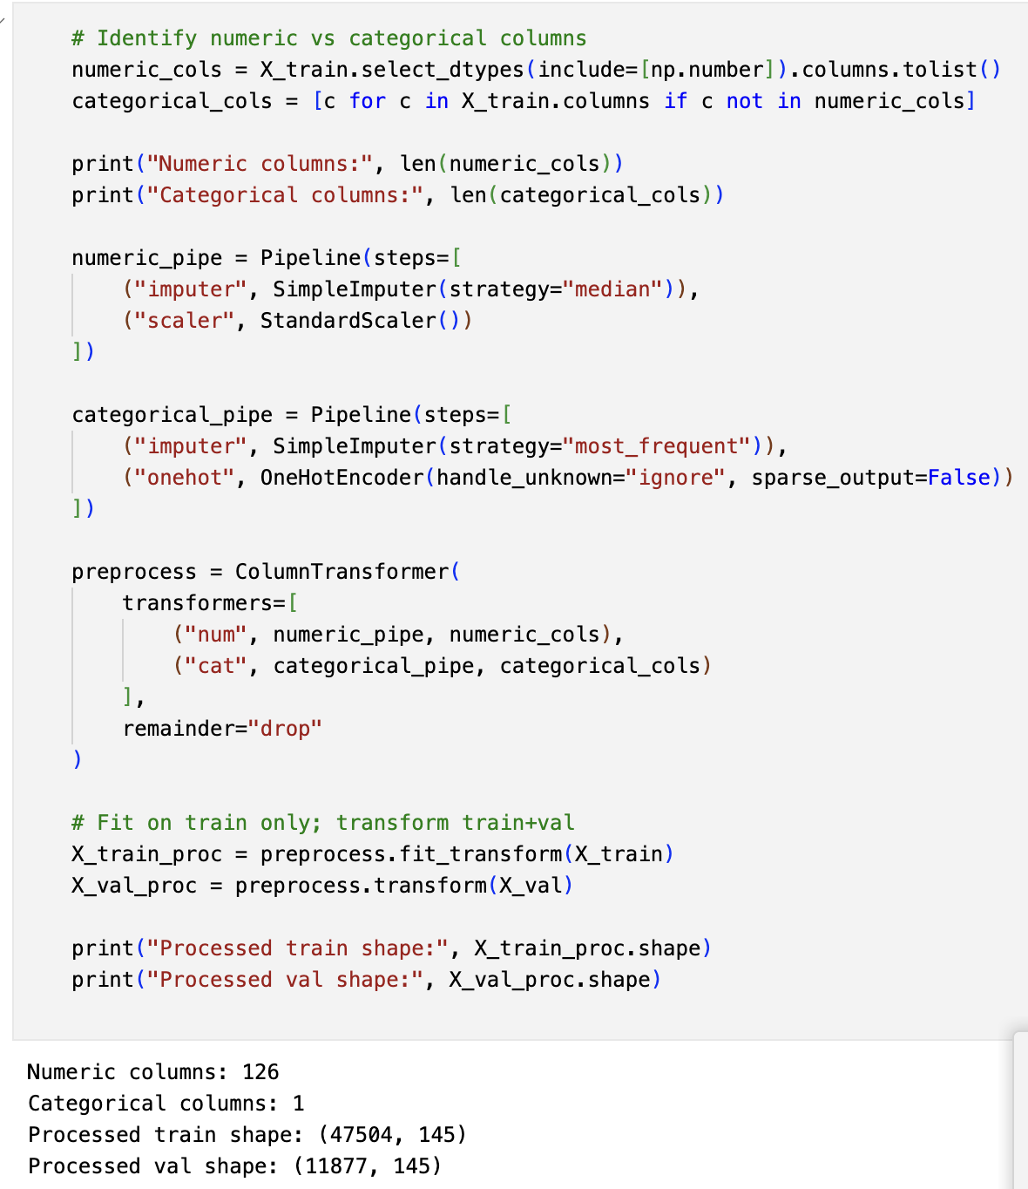
Data Preparation and Preprocessing
The dataset contains mixed feature types (numeric + categorical) and missing values.
Preprocessing pipeline:
Numeric: median imputation + StandardScaler
Categorical: most-frequent imputation + one-hot encoding
Train/Validation split with stratification
Why:
Neural networks require numeric input
Scaling stabilizes gradient-based training
Stratified split preserves ordinal class distribution

Slide 4
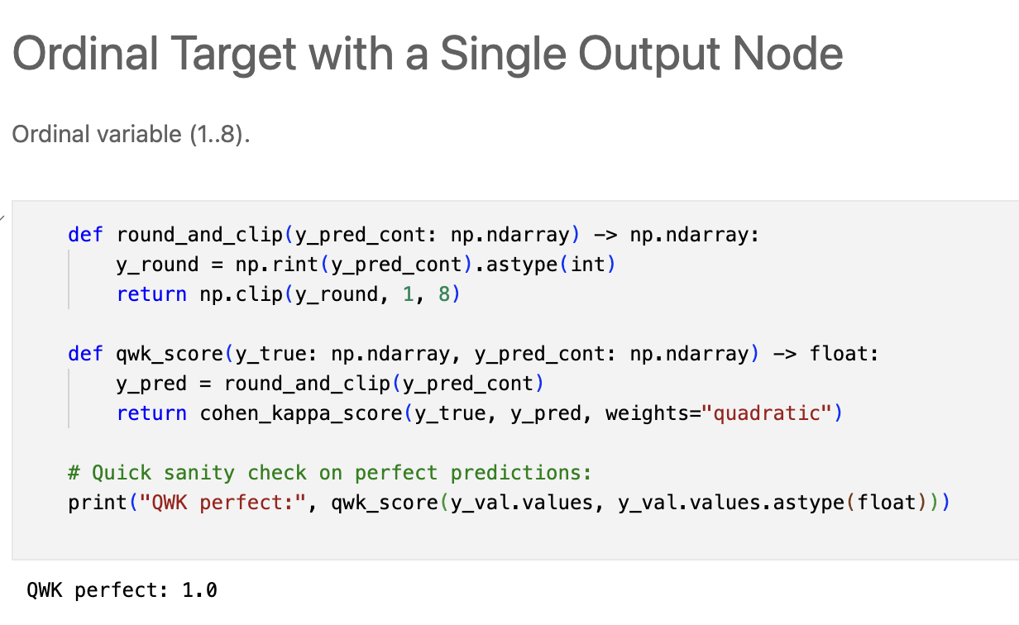
Ordinal Target with a Single Output Node
Response is ordinal (1–8), so we used a single output neuron (linear activation).
Approach:
Treat ordinal prediction as scalar regression:
model outputs y_hat (continuous)
Convert to class labels using round + clip to {1..8}
This respects ordering and distance:
Predicting 8 instead of 7 is less severe than predicting 8 instead of 1

Slide 5
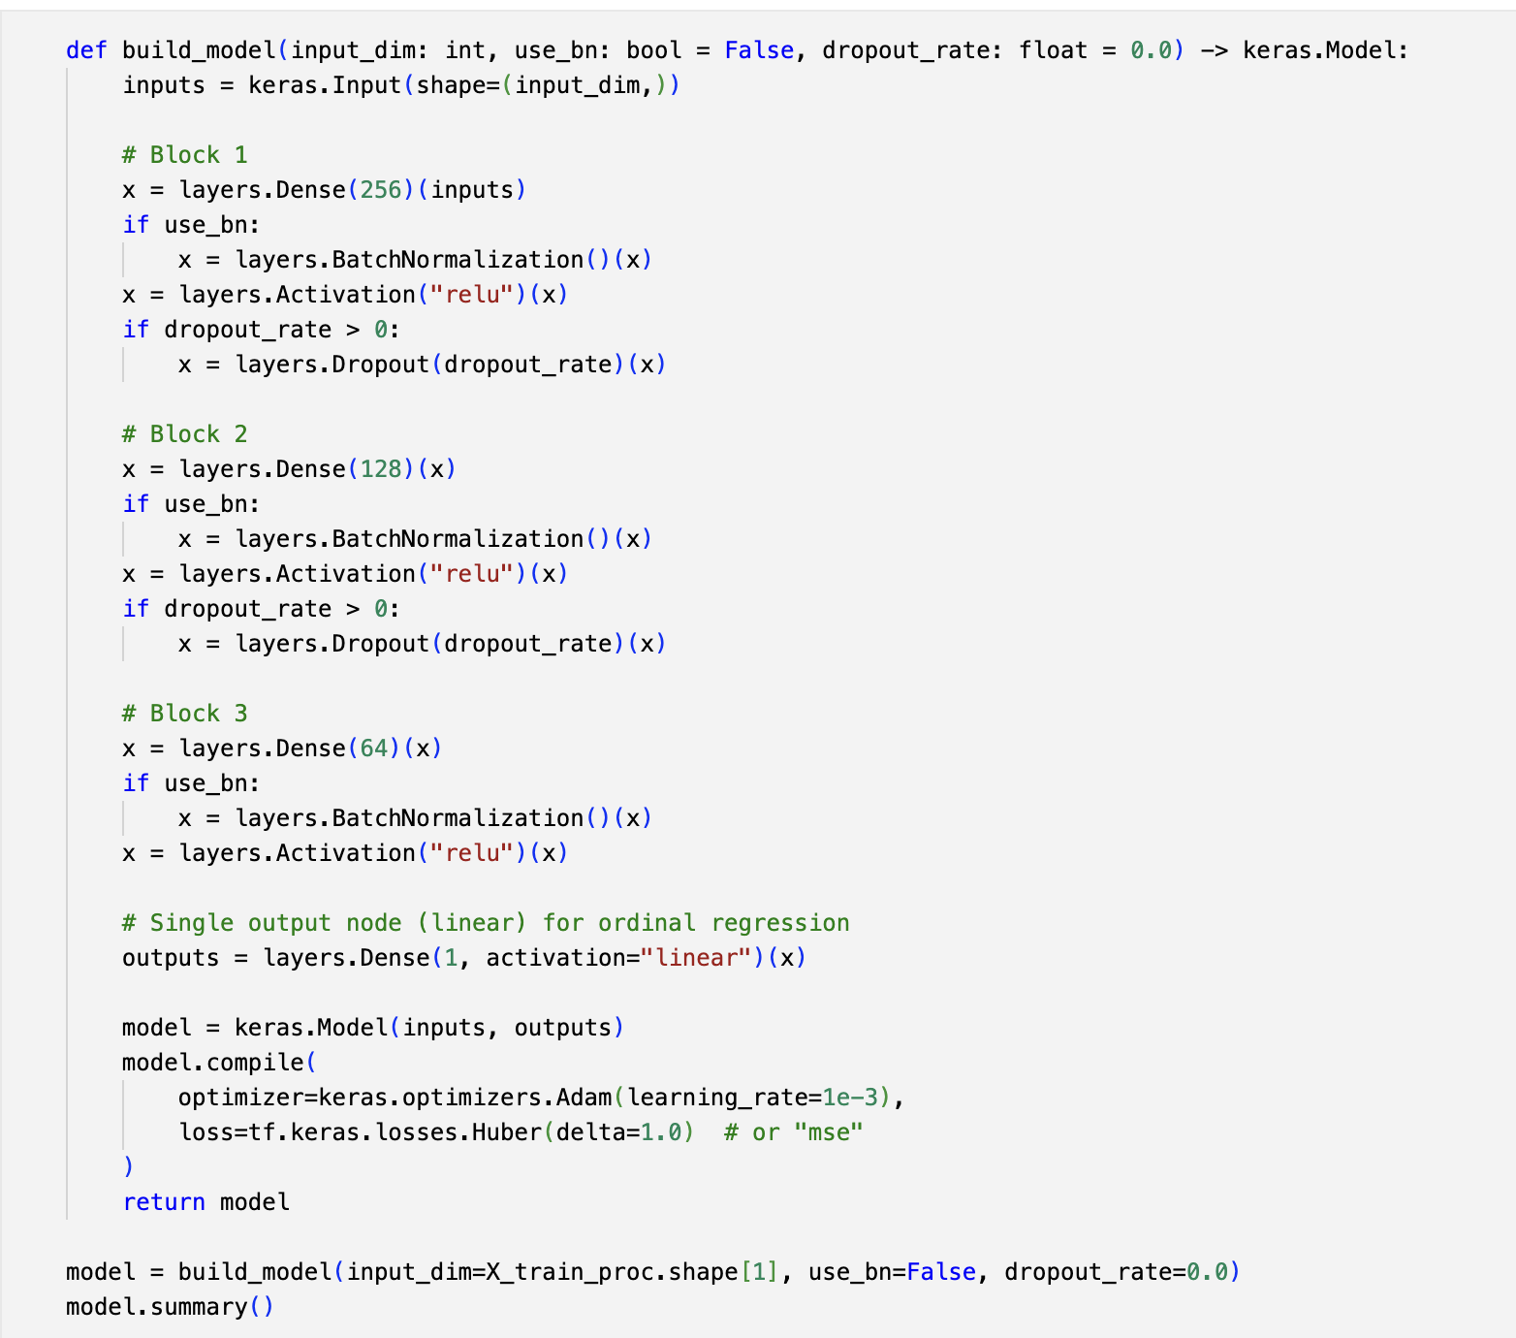
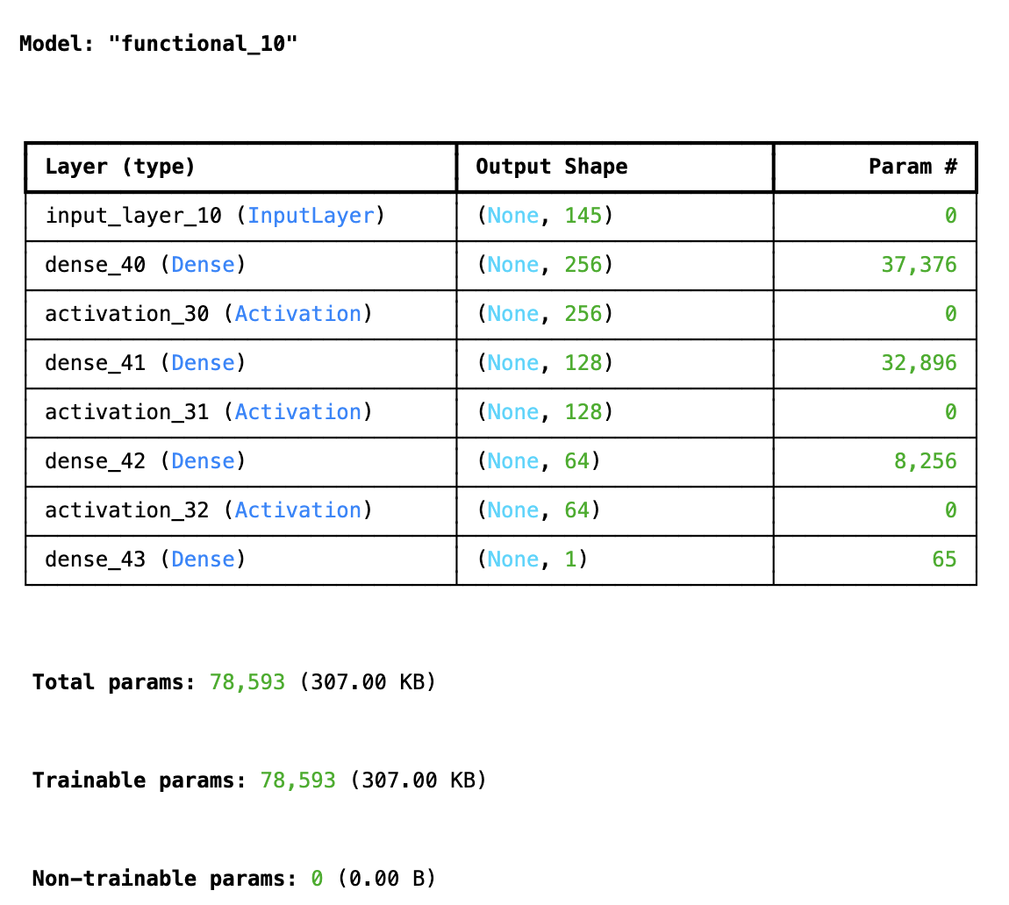
Loss Function (Cost) and Evaluation Metric
Loss (training objective):
Huber loss (robust regression loss), suitable for ordinal distance
(MSE is also valid for ordinal regression)
Evaluation metric:
Quadratic Weighted Kappa (QWK)
Measures agreement while penalizing larger ordinal errors more heavily
Workflow:
Train using Huber loss
Evaluate with QWK after rounding predictions to 1–8

Slide 6
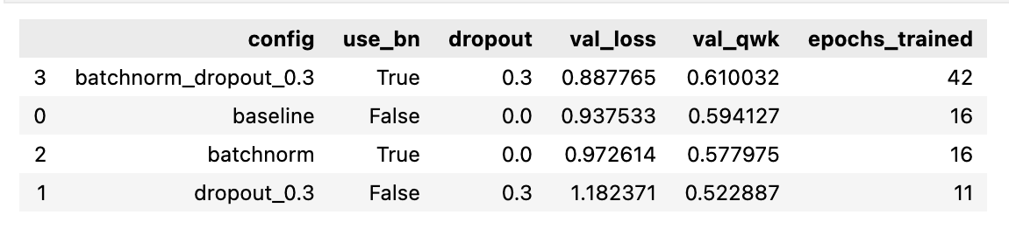
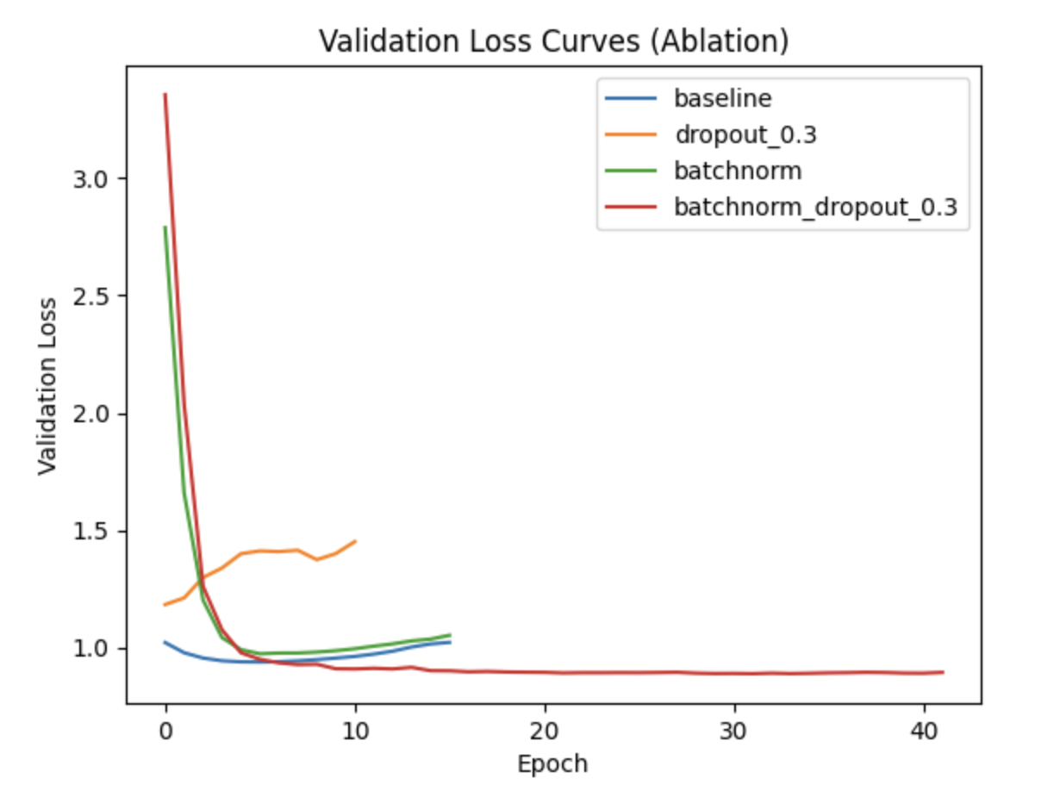
Ablation Study : Dropout vs Branch Normalisation
We tested 4 configurations to isolate effects:
1) baseline: no BN, no Dropout
2) dropout only: Dropout=0.3
3) batchnorm only: BN enabled
4) batchnorm + dropout: BN + Dropout=0.3
We compared validation loss and validation QWK to study generalization and stability.

Slide 7
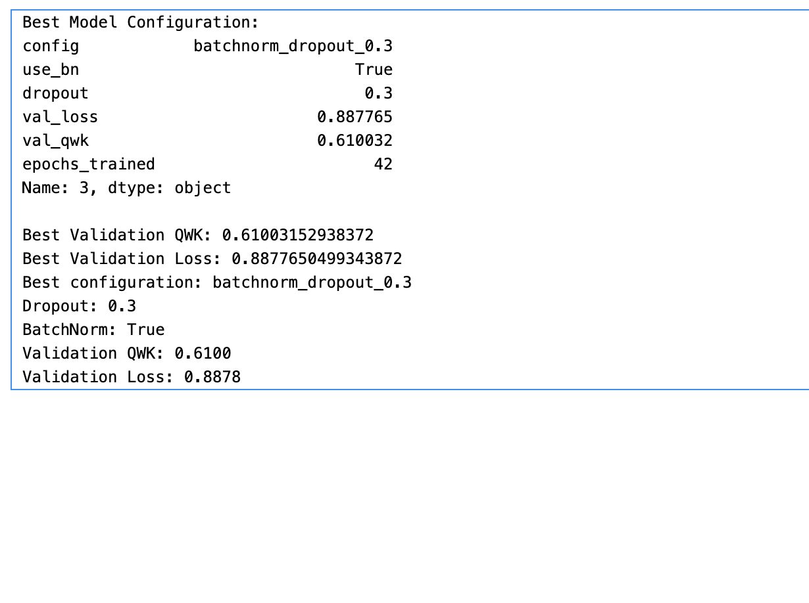
Results and Conclusions

